Slide 1
Improving Power BI Performance
@Anniexu1990

Slide 2
Who I am
Dan (Annie) Xu
Microsoft Cloud Solution Architect (OCP)
Blog: https://anniexu1990.com
All social media accounts (including gmail): anniexu1990

Slide 3

Understand it -> Improve it
Notes:
Why I am here?
70% demo
Mid question 1-2 minutes
Thermology
Appendix
Slide location and questions

Slide 4
Agenda
Level setting
The Vertipaq engine
Query Architecture Essentials
Optimization for Query Performance
Thinking in a bigger picture

Slide 5
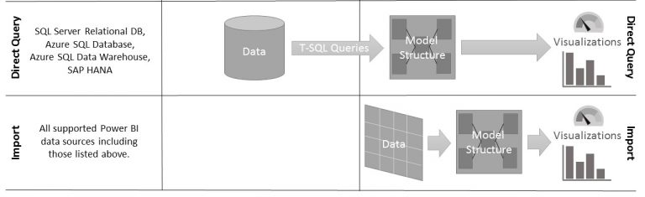
Level setting - Imported Mode vs. Direct Query mode
Data Source
Power BI

Slide 6
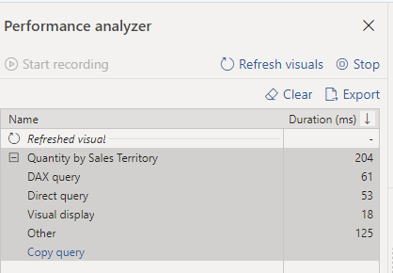
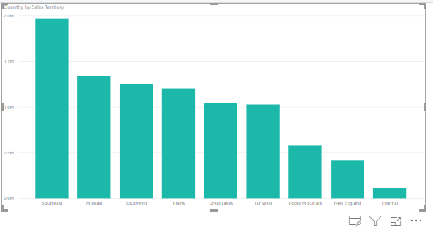
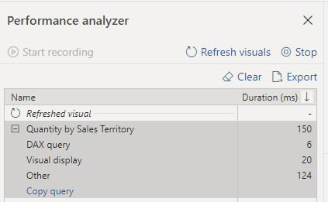
Compare the difference
Direct Query Mode
Import Mode

Slide 7
Understand the Vertipaq engine
Notes:
DAX runs in SQL Server Analysis Services (SSAS) Tabular, Power BI service (both on server and on the local Power BI Desktop), and in the Power Pivot for Microsoft Excel add-in.
When SSAS loads the content of a source table in memory, we say that it processes the table. This happens during the process operation of SSAS or the data refresh in Power Pivot for Excel and Power BI. During processing, the engine reads the content of your data source and transforms it in the internal VertiPaq data structure.

Slide 8
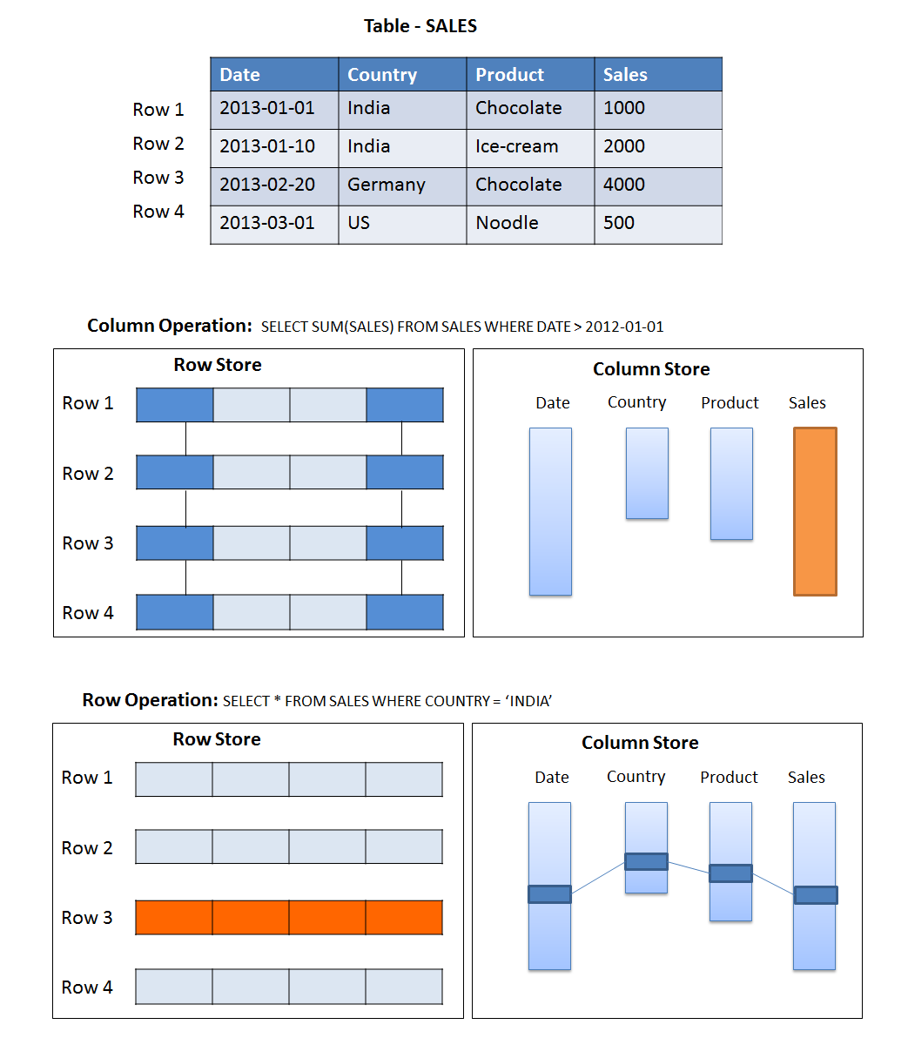
Column Store vs. Row Store
http://saphanatutorial.com/column-data-storage-and-row-data-storage-sap-hana/

Slide 9
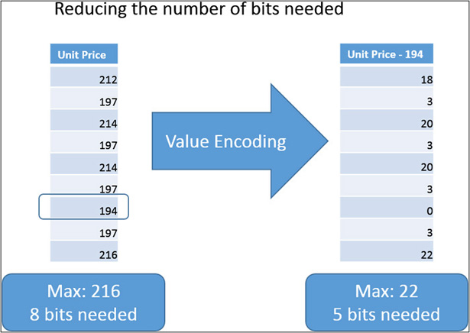
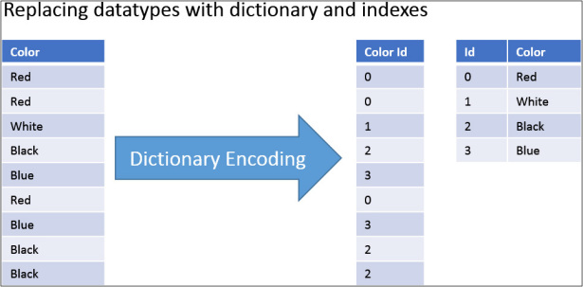
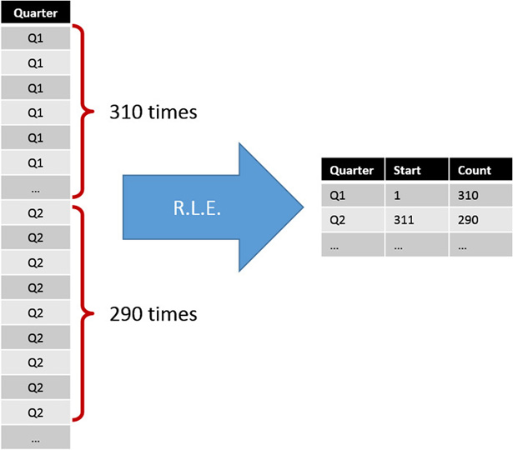
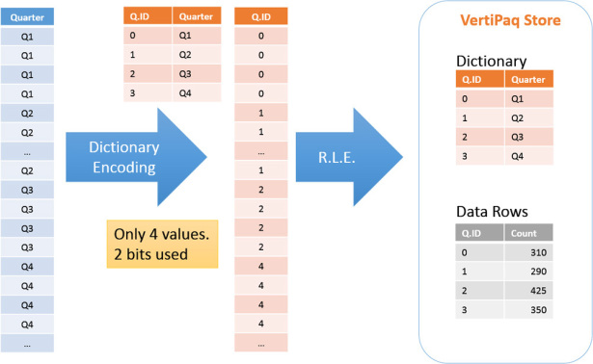
Compression
http://saphanatutorial.com/column-data-storage-and-row-data-storage-sap-hana/

Slide 10
What happens when data is imported from source to Power BI
Reading of the source dataset, transformation into a columnar data structure of VertiPaq, encoding and compressing each column.
Creation of dictionaries and indexes for each column.
Creation of the data structures for relationships.
Computation and compression of all the calculated columns.
https://www.microsoftpressstore.com/articles/article.aspx?p=2449192

Slide 11
Optimization for Vertipaq memory usage
Analyze biggest tables
Total column size, dictionary size (Hash)
Analyze largest relationships
Total table size, Number of records and columns
Number of partition and segments, ~ records per segments
Analyze biggest columns
Data Type, Cardinality
Encoding type (value, hash)

Slide 12
Data Model is a Key Driver for query performance
Even the best DAX in the world can struggle against a poorly designed model
Lots of performance issues are cause by model designs which not follow best practices
As model get larger, adherence to best practice in design becomes more and more important
Recommended reading: Modeling for AS Tabular scalability whitepaper

Slide 13
Demo time!
Your Tool: Vertipaq Analyzer

Slide 14
Query Architecture Essential

Slide 15
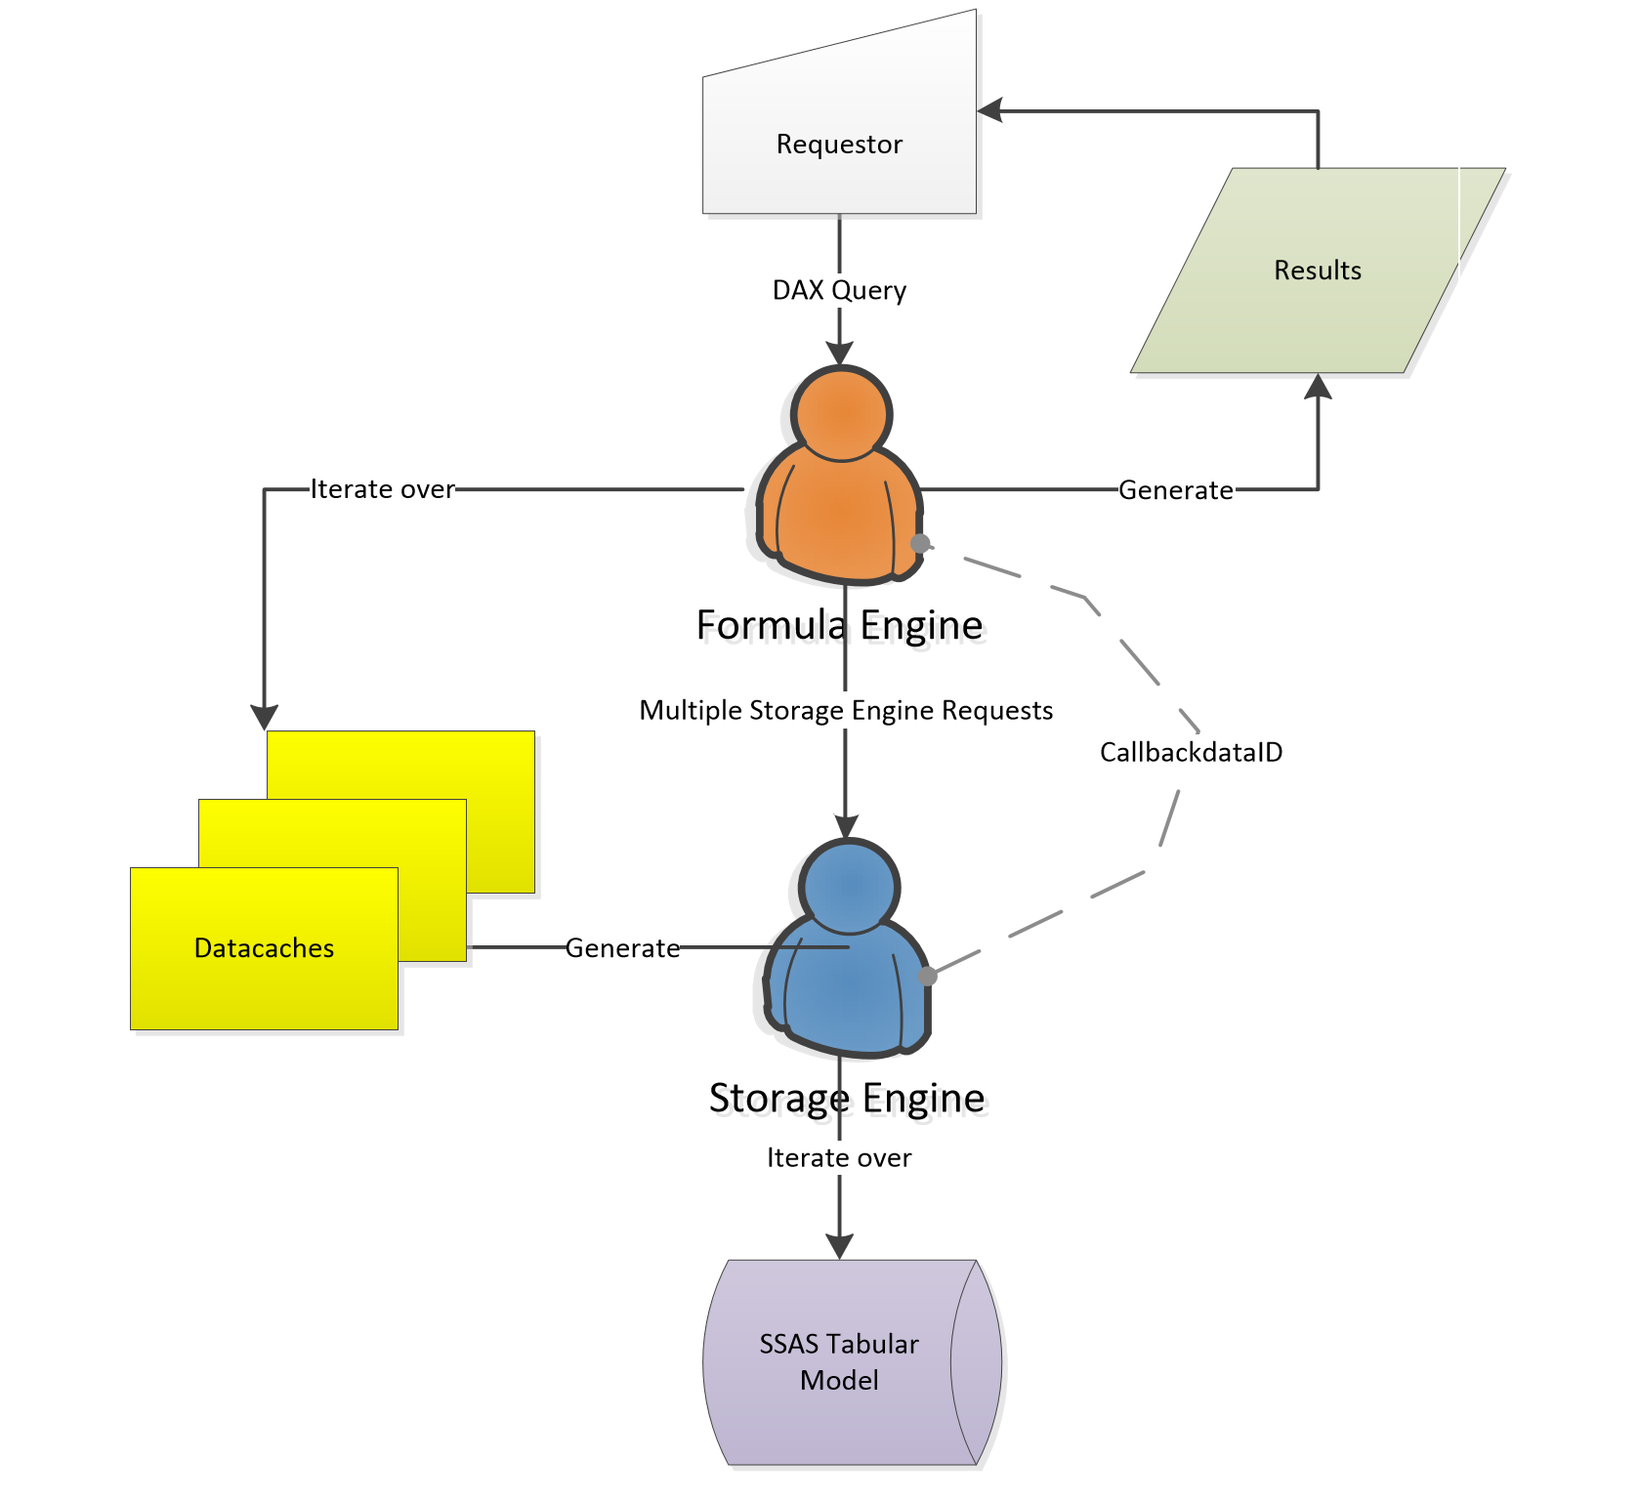
Formula Engine vs. Storage Engine
Category | Formula Engine | Storage Engine
Thread | Single - Threaded | Multi – Threaded
Characteristics | Very Smart! | Very Fast!
Main function | Build execution plans Handle complex expressions against datacaches | Handle simple arithmetic calculations Execute queries against the compressed data in VertiPaq storage
Cache utilization | No | Yes
Performance Tuning | Check physical plan | Check xmSQL queries (a textual representation of SE query)

Slide 16
Vertipaq Cache
Goal: Improve the performance of multiple requests of the same data cache within the same query or different queries requesting the same datacache
Only result of Storage Engine is Cached (FE does not have any)
Vertipaq engine can reuses data in cache only when the cardinality is the same and the columns are a subset of a previous query

Slide 17
CallbackDataID
The SE only supports a limited set of operators and functions in xmSQL. It cannot calculated complex logic such as conditional logic, advanced math
When a calculation is required within a VertiPaq iterator, the SE may call FE using a special xmSQL function called CallbackDataID.
If the CallbackDataID is generated in query plan of a iterator, the SE calls the FE for every row, passing the DAX expression and the values of its members as arguments.
The result of the CallbackDataID is a data cache with only one row, corresponding to the aggregated result

Slide 18
CallBackDataID Performance
Slower than pure Vertipaq
Faster than pure Formula Engine
– Highly parallelized
– Works on compressed data
Not cached

Slide 19
Optimization for Query Performance

Slide 20
Consider Query Memory Usage
Simple queries require some memory
Complex queries require more memory Ex: Materialization of datasets
Data Cache (SE query) also requires memory

Slide 21
Optimization Standard Process
Measure performance Power BI Performance Analyzer
Analyze the query plan Dax Studio
Find a new way to rethink calculation & query (Reduce FE usage and Increase SE usage)
Measure performance gain
Loop until the expected level of performance

Slide 22
Demo time!
Your Tool: Dax Studio, Power BI Performance Analyzer
Notes:
Start with the blank page
Dax studio -> all queries
Copy paste all visuals to new visual
http://www.pass.org/Portals/333/Alberto%20Ferrari_Optimizing%20DAX%20Queries.pdf
DEFINE MEASURE 'Fact Sale'[Profit Per Quantity] = IF ( SUM ( 'Fact Sale'[Quantity] ) = 0, BLANK(), SUM ( 'Fact Sale'[Profit] ) / SUM ( 'Fact Sale'[Quantity] ) ) MEASURE 'Fact Sale'[Profit Per Quantity 2] = CALCULATE ( SUM ( 'Fact Sale'[Profit] ) / SUM ( 'Fact Sale'[Quantity] ), 'Fact Sale'[Quantity] <> 0 ) EVALUATE SUMMARIZECOLUMNS ( 'Dimension Stock Item'[Stock Item], "Profit Per Quantity", FORMAT ( [Profit Per Quantity], "Percent" ) ) ORDER BY [Profit Per Quantity] DESC, 'Dimension Stock Item'[Stock Item]

Slide 23

Thinking in a bigger picture

Slide 24
More horse power
Power BI pro, Power BI premium, Power BI embedded
Use SSAS Tabular Server (Hardware considerations)
Direct Query: more powerful data pipeline engine (SQL Server, Azure SQL Data Warehouse edc.

Slide 25


Slide 26
Appendix List
Useful Links
Key Concepts
Useful Tools for DAX and Tabular Modeling

Slide 27
Useful Links
https://www.sqlbi.com/
https://powerpivotpro.com
http://anniexu1990.com
Book: The Definitive Guide to DAX

Slide 28
Key Concepts
Column store vs. row store technology
Vertipaq compression
Row context vs. filter context
Formula Engine vs. Storage Engine

Slide 29
Useful Tools for DAX and Tabular Modeling
DAXStudio
Vertipaq Analyzer
DAX Editor

Slide 30
Performance Tuning for DAX
“The most important factor of DAX formula speed is data distribution”
Vertipaq Analyzer
Formula Engine Bottlenecks
Redundant logic steps
Long iterations over datacaches
Storage Engine Bottlenecks
Long Scan time
Large cardinality
High frequency of CallbackdataID (a function in Storage Engine communicating back to formula engine for complicated calculations which disable the cache)
Large materialization

Slide 31
Some Query Performance Tuning Techniques
User Variables when you can precompute some calculations
When possible, replace cumulated IF conditions by CALCULATE with separated conditions expression
Avoid complex FILTERS in the came CALCULATE single conditions (use separated conditions)
Use IFERROR sparingly
When possible replace DIVIDE by condition in the CALCULATE
Reduce useless iterations (change the grain of the table inside the iterator)
Adjust the model design to remove complex “on the fly” computation (reduce FE cpu time)
Look at the number of xmSQL queries and rows returned by Storage Engine
Try to avoid CallBack (ex: complex filter)
Try to avoid Materializations (ex: complex join or iterator)

